Slide 1
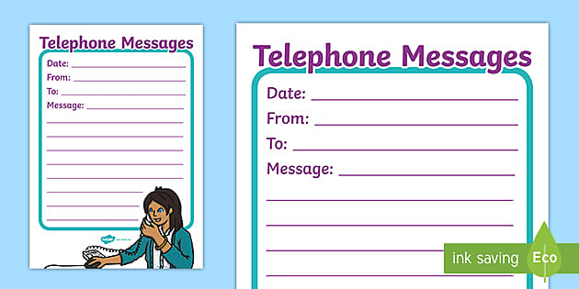
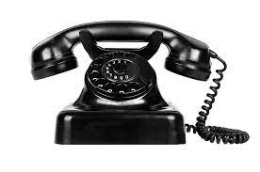
UNIT 2: MAKING ARRANGEMENTS
LESSON: SPEAK & LISTEN

Slide 2
SPEAK
1. Put the sentences in the correct order to make a complete conversation
a) I’m fine. I’m going to a pop concert at the City Concert Center tonight. Would you like to come?
b) Hello, 9 210 752
c) It’s The Kids in Town. You like it, don’t you?
d) Bye
e) Yes. What time can we meet?
f) Hello. Can I speak to Eric, please? This is Adam.
g) That’s fine. See you at 7.15. thank you, Adam.
h) Bye, Eric
i) Which band is it?
j) Hello, Adam. How are you?
k) Is 7.15 OK? The concert starts at 7.45. Let’s meet inside the center, at the café corner.
4
1
6
11
7
2
9
10
5
3
8

Slide 3
I. New words
- pop concert (n) [pɔp ˈkɔnsət] : buổi hòa nhạc Pop
- band (n) /bænd/ : ban nhạc
- start (v) /stɑːrt/ bắt đầu ≠ finish: kết thúc
- inside (adv) /̖ɪnˈsaɪd/: bên trong ≠ outside /ˈaʊtsaɪd/: bên ngoài
- corner (n) /ˈkɔːrnɚ/: góc (tường, nhà phố...)
- principal (n) /ˈprɪnsəpəl/ = headmaster : hiệu trưởng
- message (n) /ˈmesɪdʒ/: lời nhắn, tin nhắn

Slide 4
2. Complete the dialogue
Ba: Hello, 8 257 012
Bao:
Ba: Hello, Bao. How are you?
Bao:
Ba: Great. Me too.
Bao:
Ba: I’m sorry. I can’t play chess tonight. I’m going to do my homework.
Bao:
Ba: Yes. Tomorrow afternoon is fine.
Bao:
Ba: At the Central Chess Club? OK. Let’s meet at the front door.
Bao:
Ba: Great. See you tomorrow afternoon at 2.00 o’clock.
Hello. Can I speak to Ba, please? This is Bao.
I’m fine. Thanks. How are you?
Can you play chess tonight?/
Would you like to play chess tonight?
What about tomorrow afternoon?
I’ll meet you at the Central Chess Club
Is 2.00 OK?/
Can we see each other at 2.00?

Slide 5
IV. Listen
“A women phoned the principal of Kingston Junior High school, but he was out…"
KINGSTON JUNIOR HIGH SCHOOL
DATE: ___________________ TIME: ___________________
FOR: The Principal
MESSAGE:_______________________________________________________________________________________________
TELEPHONE NUMBER: ______________________________
Tuesday
9:45
Mrs Mary Nguyen wanted to see you at 9:45 on Tuesday morning
64683720942

Slide 6
Tapes script:
Secretary: Kingston Junior High School
Woman: Good afternoon. Could I talk to the principal, please?
Secretary: I’m afraid Mr. Kelvin is out at the moment. Would you like to leave a message?
Woman: Uhm, no. But I’d like to make an appointment to see him.
Secretary: I think he will be available on Tuesday.
Woman: Tuesday's OK. Can I see him in the morning?
Secretary: Sure, you can. What time would you like to come?
Woman: Is 10.30 OK?
Secretary: I'm sorry. The principal will have a school visit at 10.30. What about 9.45?
Woman: 9.45? Let me see. Yes. it’s alright.
Secretary: What's your name, please?
Woman: My name's Mary Nguyen.
Secretary: Is that N-G-U-Y-E-N?
Woman: Yes. that's right. Mrs. Nguyen.
Secretary: And your address, please?
Woman: Number 23, 51st Street. My telephone number is 64683720942.
Secretary: Thank you, Mrs. Nguyen.
Woman: Thank you very much.

Slide 7
II. Homework
- Learn new words by heart
- Do exercise
- Prepare Unit 2: Read/ p.21,22

